Slide 1

Introduction
Evolution
Process
Memory
Security
Additional Points
FreeBSD Facilities and the Kernel
The Kernel
The Kernel is part of the system that runs in protected mode and is responsible for managing hardware resources and providing fundamental services to other software components by managing processes and providing functions called system calls to access the filesystem and communication facilities.

Slide 2
Introduction
Evolution
Process
Memory
Security
Additional Points
FreeBSD Facilities and the Kernel
Difference between UNIX & FreeBSD Kernel
Unlike the earliest versions of UNIX, the FreeBSD Kernel is not partitioned into multiple processes. The monolithic kernel was chosen for simplicity and performance.
Users mostly interact with the system through a CLI called a Shell, and through additional user application programs. Both are implemented with processes rather than being part of the Kernel.

Slide 3
Introduction
Evolution
Process
Memory
Security
Additional Points
FreeBSD Facilities and the Kernel
organization of the FreeBSD kernel in two ways
1. As a static body of software, categorized by the functionality offered by the modules that make up the kernel.
2. By its dynamic operation, categorized according to the services provided to users.

Slide 4
Introduction
Evolution
Process
Memory
Security
Additional Points
FreeBSD Facilities and the Kernel
FreeBSD Kernal provides four basic facilities
Processes
Filesystems
Communications
System startup
Press Here
Press Here
Press Here
Press Here

Slide 5
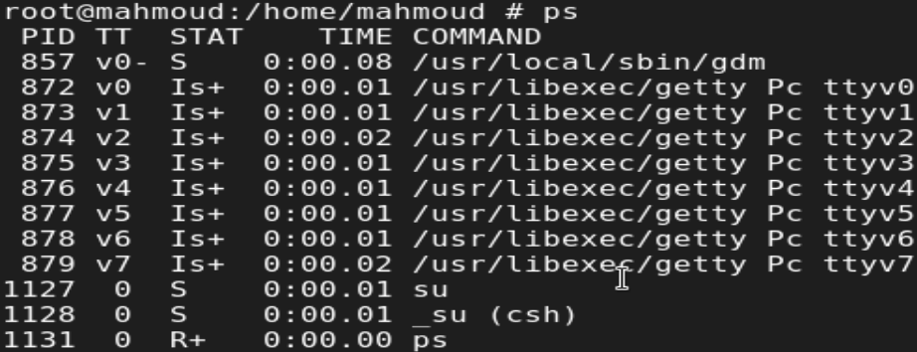
Introduction
Evolution
Process
Memory
Security
Additional Points
Composed of an address space with one or more threads of control running within it.
The system multiplexes separate virtual-address spaces for each process.
Processes
To show process States, use (PS) command to show it
Back

Slide 6
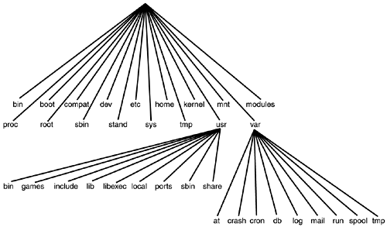
Introduction
Evolution
Process
Memory
Security
Additional Points
The filesystem provides operations to manipulate a set of named files, organized in a tree-structured hierarchy of directories. The filesystem organizes the files and directories on physical media, such as disks.
Filesystem
Back

Slide 7
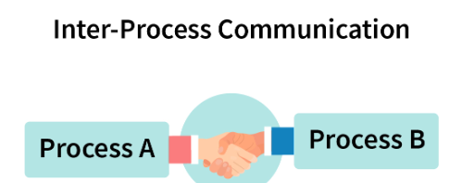
Introduction
Evolution
Process
Memory
Security
Additional Points
Provided by the traditional UNIX system, it offers a variety of communication methods like: Inter-process communication, networking, and serial communication. The specific communication method used depends on the application.
Communications
Back

Slide 8
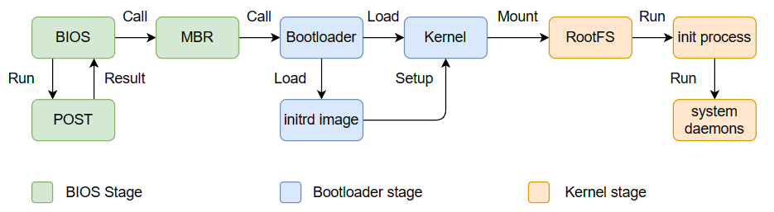
Introduction
Evolution
Process
Memory
Security
Additional Points
Complex series of events that culminate in the loading and execution of the OS Kernel. It can be broadly divided into three stages: Bootstrapping → Bootloader → Kernel Initialization
System Startup
Back

